Slide 1
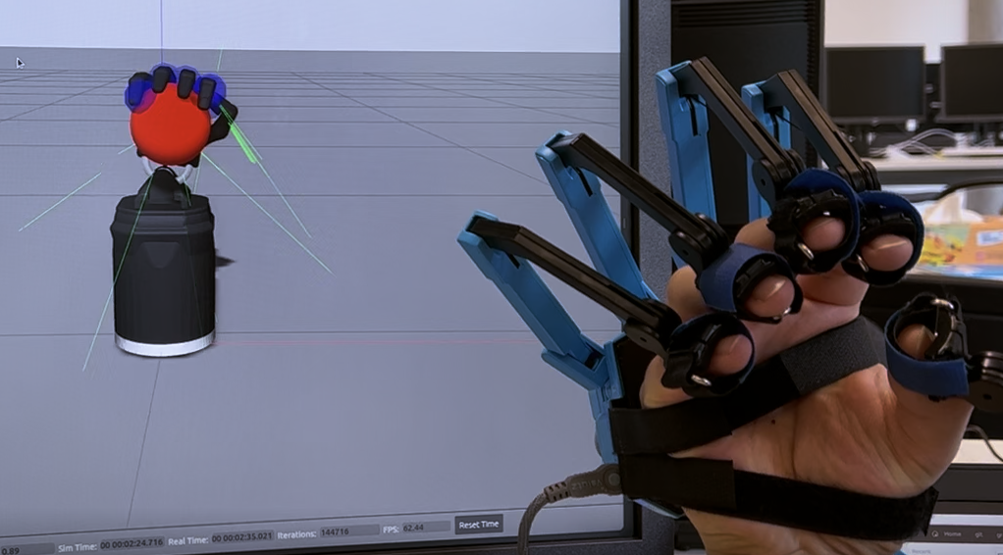
Grasping with Senseglove
Seo (Mars) Hwasung
Tianle Ni

Slide 2
Task
Mapping Shadow hand with Senseglove
2 fingers closure to full hand closure
Creat object in Gazebo
Grasp object and provide realistic haptic feedback

Slide 3
Publisher & Subscriber (ROS)
Haptic Feedback: Buzz & Force
/contacts/fingers
Mapping
joint_states
senseglove/hardware_Interface
Bridge_Node
position_controller/command
/gazebo
/senseglove_states
Mapping
finger_distances
finger_distances
2 Finger Closure to Full Hand Closure

Slide 4
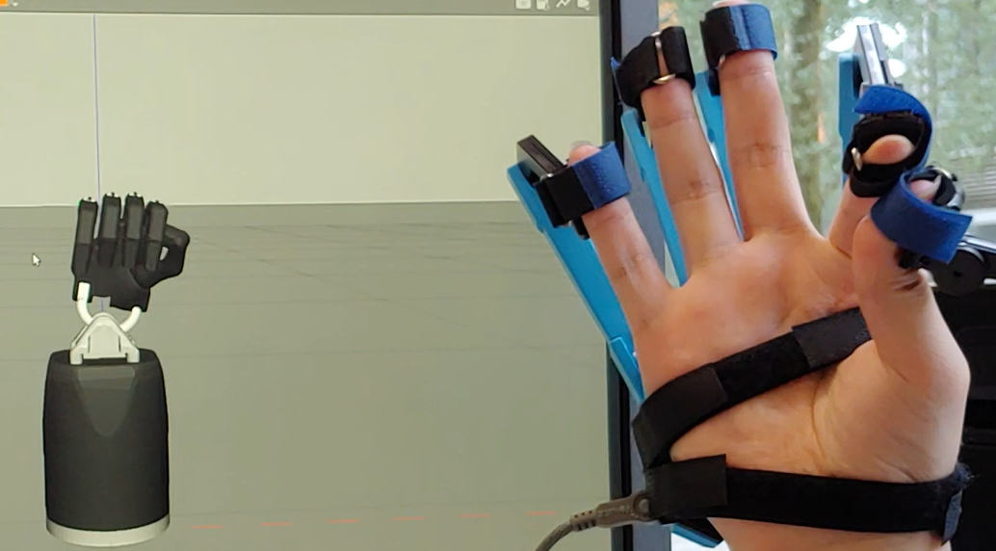
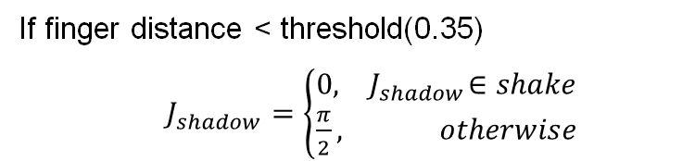
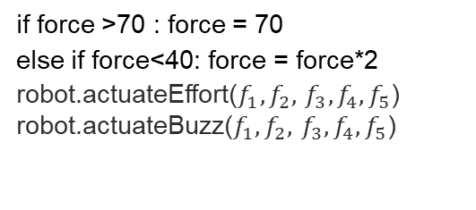
2 Finger Closure to Full Hand Closure
If finger distance < threshold(0.35)
$J_{shadow}=\left\{\begin{aligned}0,{ J}_{shadow}∈shake \\ \frac{π}{2}, otherwise\end{aligned}\right.$
Haptic Feedback: Buzz & Force(0~100)
/contacts/fingers
Feedback of force on the contact (6 dim)
force += msg.states[i].total_wrench.force.x
force += msg.states[i].total_wrench.force.y
force += msg.states[i].total_wrench.force.z
if force >70 : force = 70
else if force<40: force = force*2
robot.actuateEffort($f_{1},f_{2},$ $f_{3}, f_{4}, f_{5}$)
robot.actuateBuzz($f_{1},f_{2},$ $f_{3}, f_{4}, f_{5}$)

Slide 5
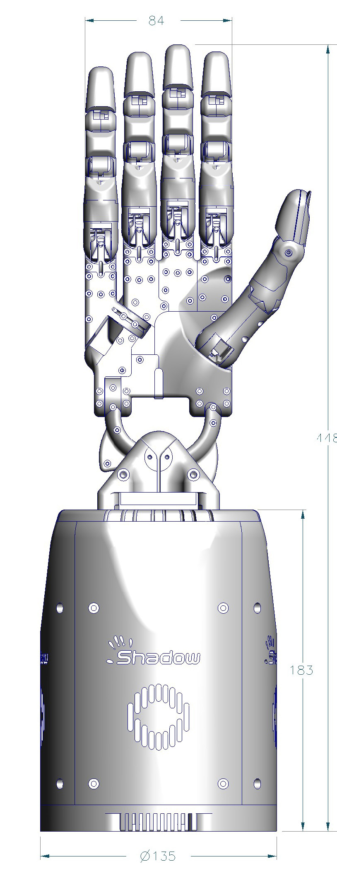
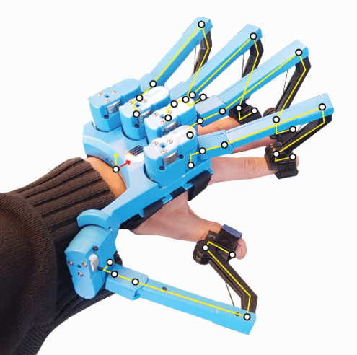
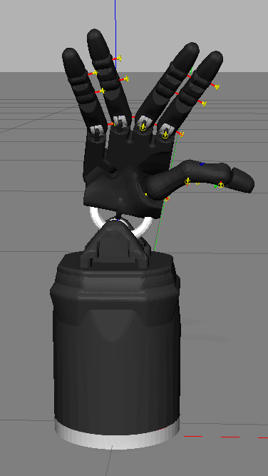
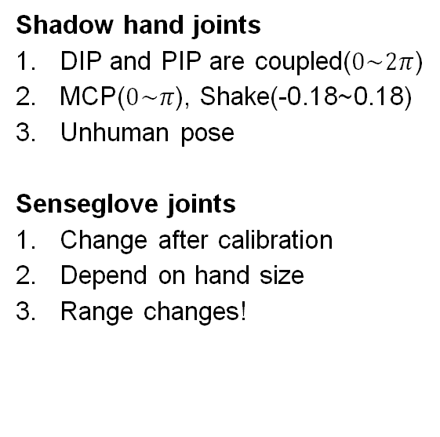
Calibration and Mapping
Senseglove
Shadow hand
Shadow hand joints
DIP and PIP are coupled($0\sim 2π$)
MCP($0\sim π$), Shake(-0.18~0.18)
Unhuman pose
Senseglove joints
Change after calibration
Depend on hand size
Range changes!
Four joints each finger
Ring, middle, Index: 3 controller
Pinky: 4 controller
Thumb: 5 controller
DIP & MCP-1 & MCP-2
PIP(discard)
Notes:
First the kinematics of senseglove and shadow hand is different
Senseglove has four joints DIP, PIP, MCP-1, MCP-2 for each finger, but it doesn’t have wrist
However, when controlling the shadow hand in Gazebo simulation. It can also control the wrist
Without considering the wrist, the Fingers have 12 controllers, 3 for ring, middle, index, 4 for pinky, 5 for thumb.
That’s why we can not just directly map senseglove to shadow hand’s joint controller. So, the redundant joints(PIP on senseglove) are removed away.
Second, the ranges of senseglove and shadow hand is different.
For shadow hand, its DIP and PIP joints are coupled and change from $0\sim 2π$, but MCP is 0~pi, shake is -0.35~0.35. Furthermore, the thumb of shadow hand can make some unhuman pose. Even worse, there is a weird setting on the shake.In the figure I set the shake as -0.35, ring/pinky are opposite to middle/index.
For senseglove, Large hand and small hand affect the joint ranges of senseglove. The glove has its own program to do the calibration, but its joint values will change very time.
We test with large hand and small hand, but the values are still different after calibration.
These are the difficulties lying in mapping senseglove to shadow hand

Slide 6
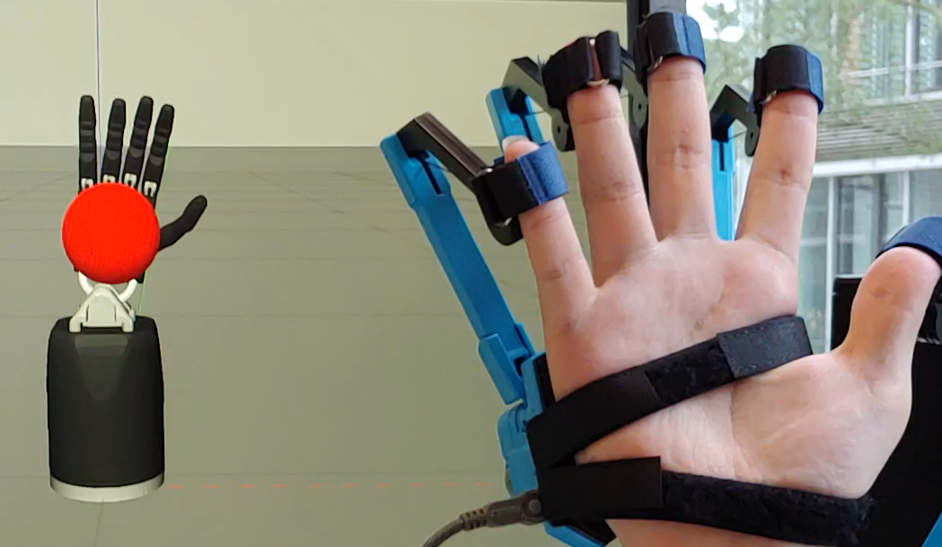
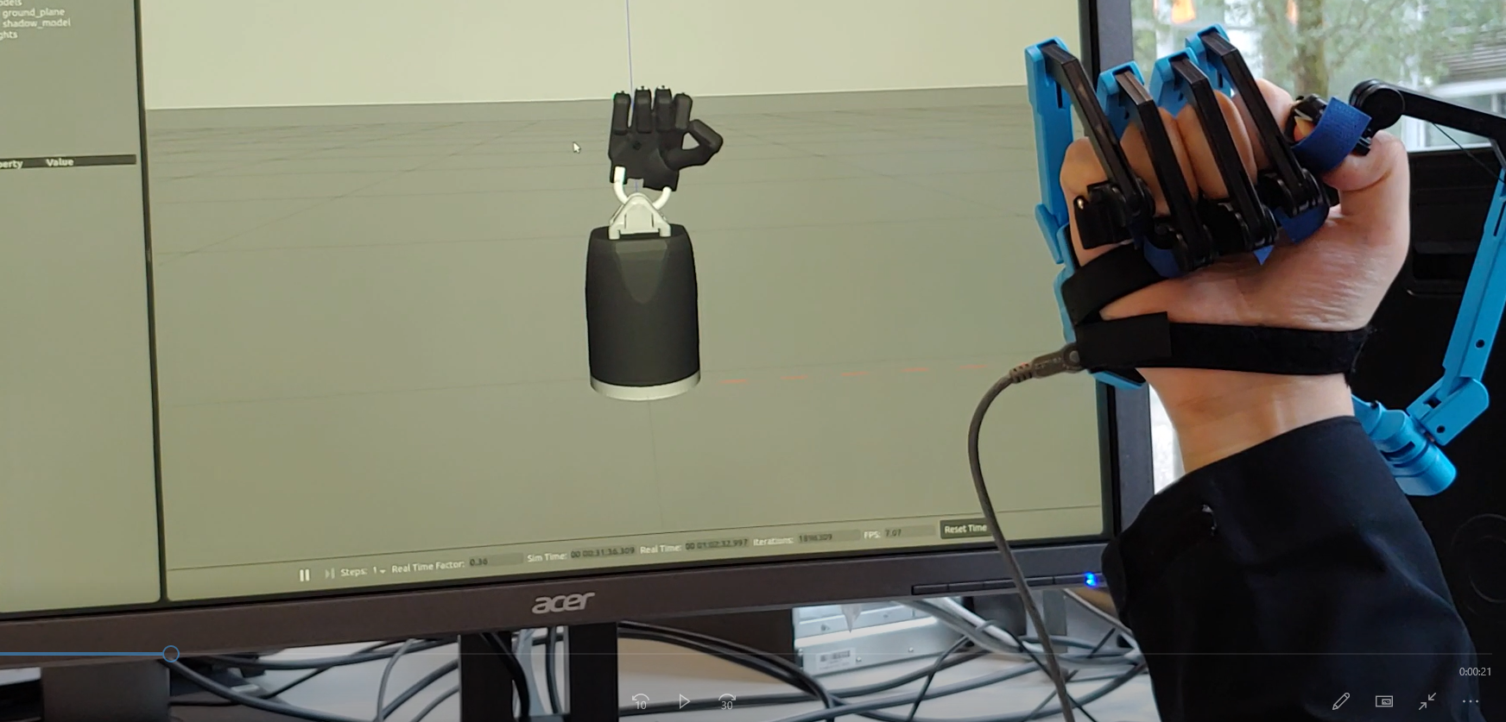
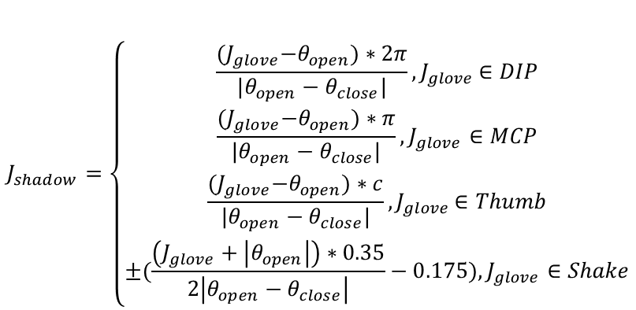
Calibration and Mapping
Open Position(low bound)
$$J_{shadow}=\left\{\begin{aligned}\frac{{(J}_{glove}−θ_{open})∗2π}{|θ_{open}−θ_{close}|}{, J}_{glove}∈DIP \\ \frac{{(J}_{glove}−θ_{open})∗π}{|θ_{open}−θ_{close}|}, J_{glove}∈MCP \\ \frac{{(J}_{glove}−θ_{open})∗c}{|θ_{open}−θ_{close}|}{, J}_{glove}∈Thumb \\ ±(\frac{\left(J_{glove}+\left|θ_{open}\right|\right)∗0.35}{2\left|θ_{open}−θ_{close}\right|}−0.175), J_{glove}∈Shake\end{aligned}\right.$$
Close Position(upper bound)
Fit for different hand size
Concise mapping
Notes:
With these problems and understanding in mind, we design an own calibration to fit for different hand size, then everyone’s hand can match concisely to shadow hand
In the calibration, we first open the hand and spread as much as possible. In this case, most of joint values are small, so set as low bound
Then we close the hand as a fist and set as upper bound.
After calibration, the senseglove and shadowhand can perfectly correspond to each other.

Slide 7
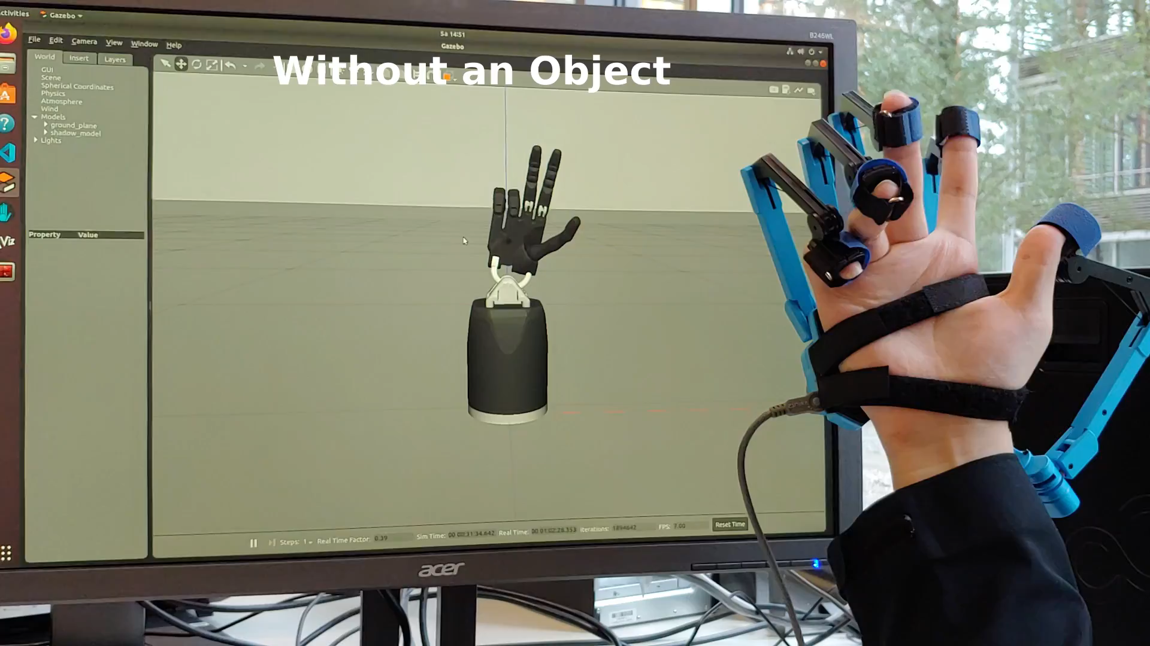
Result

Slide 8
Thank for your attention

